Slide 1
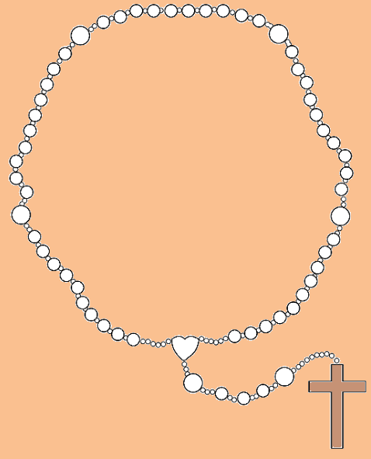
The Holy Rosary
The Luminous Mysteries
Urney Parish
Notes:
The Rosary is a prayerful reflection of the Gospels. It comprises 20 Mysteries or significant events in the life of Jesus and Mary. These events are organized into four sets of Mysteries; Joyful, Luminous, Sorrowful and Glorious.
Having a clearer picture of the scene and significance of the Rosary Mystery will greatly enhance your and the children’s meditation. The Holy Rosary should bring about inner peace using both mental and vocal prayer. This is how your mind internalises the events of Jesus’ life.
This Power Point is a comprehensive overview of the Holy Rosary. Each mystery follows the same format and has been designed to be used as a visual stimulus for children while praying the Rosary.
There are teacher’s notes before each new mystery providing additional information including scripture, reflections, questions and prayers to encourage discussion and further reflection during each decade.
There are specific days on which to pray certain mysteries but professional judgement should be used in order to cover the breadth and depth of learning during the progression of lessons.

Slide 2
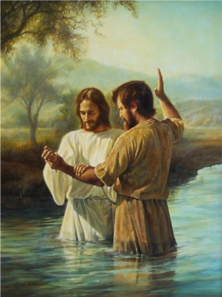
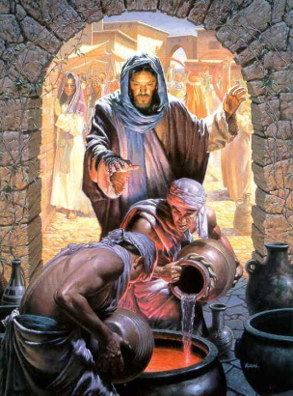
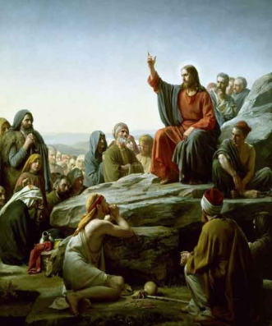
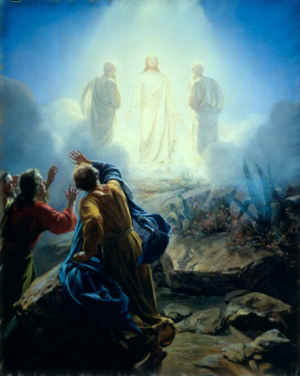
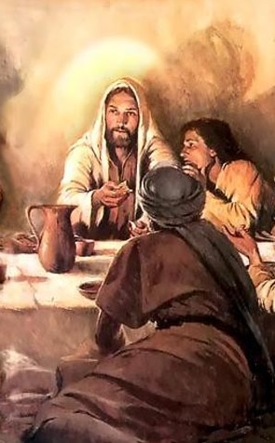
The Luminous Mysteries
Jesus is Baptised
The Wedding at Cana
Proclamation of the Kingdom
Jesus’ Transfiguration
The Institution of the Eucharist
Notes:
What a gift the Luminous Mysteries of the Rosary are. Meditating on these Mysteries of Light bring even deeper understanding to the public life of Jesus.
They fill in the blanks between the childhood of Jesus and His suffering and death on the cross.
As you increase in this depth of knowledge of the life of Jesus, you and the children will also find greater peace within your own lives by meditating upon the Luminous Mysteries of the Holy Rosary.
The Five Luminous Mysteries of the Rosary are recited on Thursdays.
"As long as I am in the world, I am the light of the world." John 9:5

Slide 3
I believe in God, the Father almighty, Creator of heaven and earth, and in Jesus Christ, his only Son, our Lord, who was conceived by the Holy Spirit, born of the Virgin Mary, suffered under Pontius Pilate, was crucified, died and was buried; he descended into hell; on the third day he rose again from the dead; he ascended into heaven, and is seated at the right hand of God the Father almighty; from there he will come to judge the living and the dead.
I believe in the Holy Spirit, the holy catholic Church, the communion of saints, the forgiveness of sins, the resurrection of the body, and life everlasting.
Amen.
Make the sign of the cross and say the…
Apostles’ Creed
Notes:
How to Pray the Rosary
1. Begin by touching the crucifix and praying the Sign of the Cross followed by the Apostle's Creed.
2. On the first large rosary bead, pray the Our Father.
3. On each of the next three beads, pray a Hail Mary.
4. On the next large bead, pray the Glory Be to the Father.
5. At the beginning of each decade, announce the "mystery" to be contemplated, for example, the first luminous mystery is “Jesus is Baptised".
6. After a short pause for reflection, recite the "Our Father", ten "Hail Marys" and the "Glory be to the Father".
After this, repeat stages 5 and 6 for the remaining four decades.
At the end of the Rosary, the Hail Holy Queen.

Slide 4
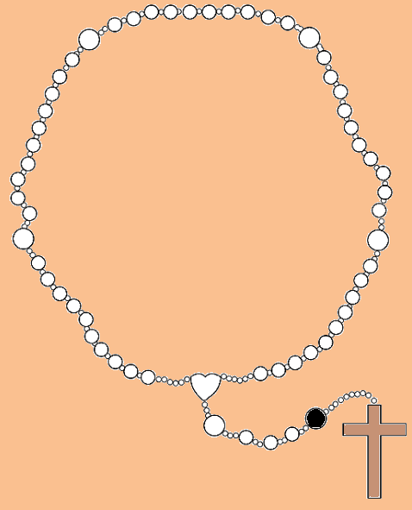
Our Father, who art in heaven,
hallowed be thy name;
thy kingdom come,
thy will be done on earth
as it is in heaven.
Give us this day our daily bread,
and forgive us our trespasses,
as we forgive those who
trespass against us;
and lead us not into temptation,
but deliver us from evil.
Amen.
Say the…
Our Father

Slide 5
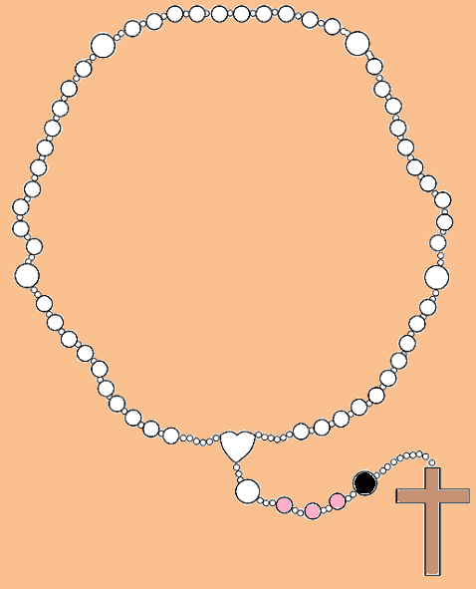
Hail Mary, full of grace.
Our Lord is with thee.
Blessed art thou among women,
and blessed is the fruit of thy womb,
Jesus.
Holy Mary, Mother of God,
pray for us sinners,
now and at the hour of our death.
Amen.
Say three…
Hail Marys

Slide 6
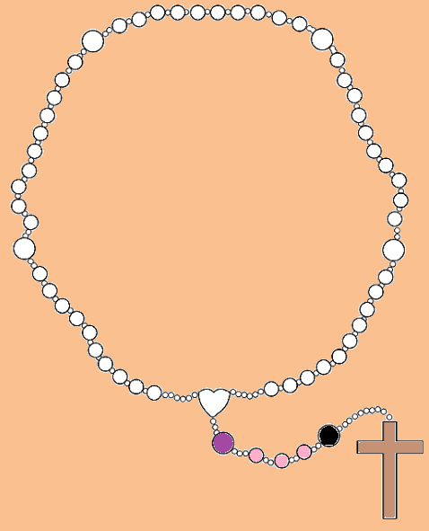
Glory be to the Father, and to the Son, and to the Holy Spirit.
As it was in the beginning, is now, and ever shall be, world without end.
Amen.
Say the…
Glory be to the Father

Slide 7
The First Luminous Mystery
Jesus is Baptised
Our Father
Hail Mary
Notes:
Matthew 3:13-17
¹³ Then Jesus came from Galilee to the Jordan to be baptized by John. ¹⁴ But John tried to deter him, saying, “I need to be baptized by you, and do you come to me?”
¹⁵ Jesus replied, “Let it be so now; it is proper for us to do this to fulfil all righteousness.” Then John consented.
¹⁶ As soon as Jesus was baptized, he went up out of the water. At that moment heaven was opened, and he saw the Spirit of God descending like a dove and alighting on him. ¹⁷ And a voice from heaven said, “This is my Son, whom I love; with him I am well pleased.”
Reflection
In His own baptism, Jesus is calling us to follow Him. It is a personal invitation to all of us. When He reveals Himself to us, He gives us the basis of our faith and the hope of our own salvation. He is showing us how much He loves us by coming personally into our lives. Our baptism is our initiation into our faith—the beginning. In our baptism, God reveals Himself to us and personally invites us to follow Him.
Questions
Do I accept the invitation of God to follow Him, which begins at my baptism and continues each day of my life?
Do I renew my baptism each day by repenting my sins, rejecting sin, and following Jesus?
We Pray for Openness to the Holy Spirit
We pray that each day we recall our baptism of repentance— our beginning; that we are filled with the Holy Spirit and renewed in our faith in God.

Slide 8
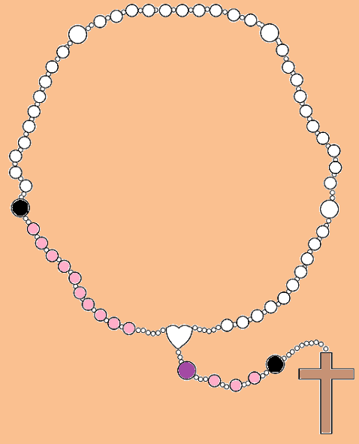
Glory be to the Father, and to the Son, and to the Holy Spirit.
As it was in the beginning, is now, and ever shall be, world without end.
Amen.
Say the…
Glory be to the Father

Slide 9
The Second Luminous Mystery
The Wedding at Cana
Our Father
Hail Mary
Notes:
John 2:1-11
2 On the third day a wedding took place at Cana in Galilee. Jesus’ mother was there, ² and Jesus and his disciples had also been invited to the wedding. ³ When the wine was gone, Jesus’ mother said to him, “They have no more wine.” ⁴ “Woman, why do you involve me?” Jesus replied. “My hour has not yet come.” ⁵ His mother said to the servants, “Do whatever he tells you.” ⁶ Nearby stood six stone water jars, the kind used by the Jews for ceremonial washing, each holding from twenty to thirty gallons.⁷ Jesus said to the servants, “Fill the jars with water”; so they filled them to the brim.⁸ Then he told them, “Now draw some out and take it to the master of the banquet.” They did so, ⁹ and the master of the banquet tasted the water that had been turned into wine. He did not realize where it had come from, though the servants who had drawn the water knew. Then he called the bridegroom aside ¹⁰ and said, “Everyone brings out the choice wine first and then the cheaper wine after the guests have had too much to drink; but you have saved the best till now.” ¹¹ What Jesus did here in Cana of Galilee was the first of the signs through which he revealed his glory; and his disciples believed in him.
Reflection
When His Mother comes to Him with the dilemma. He says to her, “Dear woman, why do you involve Me?” In saying this, Jesus reveals to us that He has not come for Himself. This is not His problem. He has come to serve, not to be served. He shows compassion for the bride and the groom. He converts the water into wine—the common into the finest. Likewise, He has come to convert us, common sinners into faithful believers—the finest to be presented to the “Master of the banquet.”
Questions
Do I recognize that, like Jesus, I too am called to serve?
Am I prepared to be converted from the common to the finest?
We Pray to Jesus Through Mary
We pray that each day we see our opportunities to serve in the manner of Jesus, so that we may be converted from the common to the finest.

Slide 10
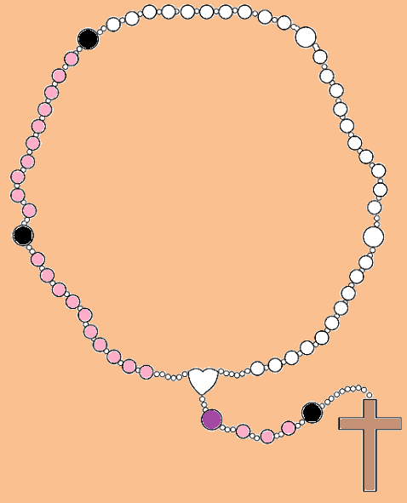
Glory be to the Father, and to the Son, and to the Holy Spirit.
As it was in the beginning, is now, and ever shall be, world without end.
Amen.
Say the…
Glory be to the Father

Slide 11
The Third Luminous Mystery
Proclamation of the Kingdom
Our Father
Hail Mary
Notes:
Mark 1:14-15
¹⁴ After John was put in prison, Jesus went into Galilee, proclaiming the good news of God. ¹⁵ “The time has come,” he said. “The kingdom of God has come near. Repent and believe the good news!”
Reflection
Throughout the Gospels, Jesus reveals the Kingdom of God to us in various ways. But the message is always clear and consistent. We are called to God’s Kingdom through Jesus Christ. He came into our world to show us the way. We are to repent for our sins and trust in God. For He, in His mercy, will forgive our sins and draw us to Him.
Questions
Do I seek the Kingdom of God each day by saying sorry and praying for His mercy?
Do I follow the example of Jesus each day by trusting completely in God for all things?
We Pray for Repentance and Trust in God
We pray for the grace and mercy of God so that we might empty ourselves and enter into His Kingdom by turning all things over to Him.

Slide 12
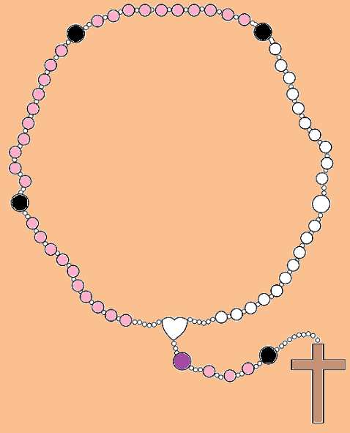
Glory be to the Father, and to the Son, and to the Holy Spirit.
As it was in the beginning, is now, and ever shall be, world without end.
Amen.
Say the…
Glory be to the Father

Slide 13
The Fourth Luminous Mystery
Jesus’ Transfiguration
Our Father
Hail Mary
Notes:
Luke 9:28-35
²⁸ About eight days after Jesus said this, he took Peter, John and James with him and went up onto a mountain to pray. ²⁹ As he was praying, the appearance of his face changed, and his clothes became as bright as a flash of lightning. ³⁰ Two men, Moses and Elijah, appeared in glorious splendour, talking with Jesus. ³¹ They spoke about his departure,^{[a]} which he was about to bring to fulfilment at Jerusalem. ³² Peter and his companions were very sleepy, but when they became fully awake, they saw his glory and the two men standing with him. ³³ As the men were leaving Jesus, Peter said to him, “Master, it is good for us to be here. Let us put up three shelters—one for you, one for Moses and one for Elijah.” (He did not know what he was saying.) ³⁴ While he was speaking, a cloud appeared and covered them, and they were afraid as they entered the cloud. ³⁵ A voice came from the cloud, saying, “This is my Son, whom I have chosen; listen to him.”
Reflection
The transfiguration of Jesus reveals some portion of His true glory to us. In presenting Moses and Elijah, Jesus connects the law and the prophets to Himself for us to clearly see who He is and why He is here. In His brilliant appearance, Jesus gives us a glimpse of where He is leading us — He gives the hope of salvation from sin. The voice of God the Father confirms for us and directs us to “Listen to Him.”
Questions
Do I recognize Jesus for who He really is and why He comes into our lives?
Do I see how He reveals Himself in our world today?
We Pray for the Desire for Holiness
We pray that we may recognise Jesus revealed in our world and that we may be refreshed and filled with hope for the remainder of our personal journey with Christ into the Kingdom of God the Father.

Slide 14
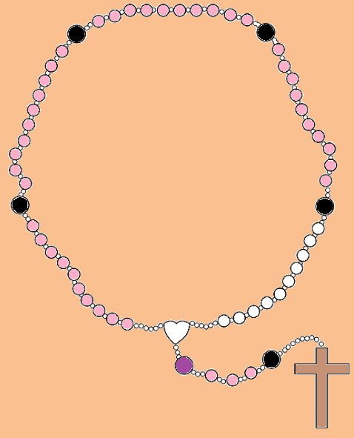
Glory be to the Father, and to the Son, and to the Holy Spirit.
As it was in the beginning, is now, and ever shall be, world without end.
Amen.
Say the…
Glory be to the Father

Slide 15
The Fifth Luminous Mystery
The Institution of the Eucharist
Our Father
Hail Mary
Notes:
Mark 14:22-25
²² While they were eating, Jesus took bread, and when he had given thanks, he broke it and gave it to his disciples, saying, “Take it; this is my body.”
²³ Then he took a cup, and when he had given thanks, he gave it to them, and they all drank from it.
²⁴ “This is my blood of the^{[a]} covenant, which is poured out for many,” he said to them. ²⁵ “Truly I tell you, I will not drink again from the fruit of the vine until that day when I drink it new in the kingdom of God.”
Reflection
Jesus reveals His sacrifice to us—He is willingly giving up His Body and His Blood for us. By taking the Body and Blood of Jesus into ourselves, we are given the grace and strength we need to follow Jesus where He is going. He tells us where He is going when He says “I will not drink again of the fruit of the vine until that day when I drink it anew in the Kingdom of God.” He gives us hope that by following Him, we too will share in His life and drink with Him in the Kingdom of God.
Question
Do I receive the Eucharist in memory of Jesus, understanding what He revealed to us in His sacrifice?
When I receive the Eucharist, do I allow the true living Body and Blood of Jesus Christ to enter me to give me the grace and strength I need to follow Him where He is going?
We Pray for Adoration
We pray that in the Eucharist we accept the true living Body and Blood of Christ to enter and dwell in us, so that we have the grace to carry us with Christ into the Kingdom of God.

Slide 16
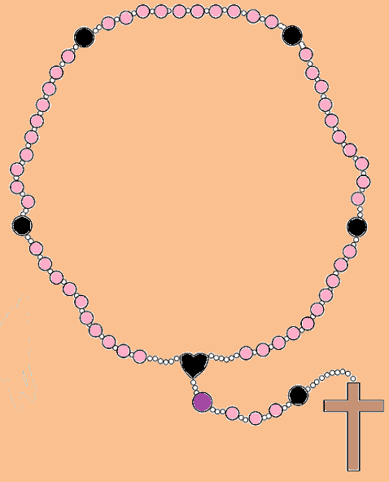
Glory be to the Father, and to the Son, and to the Holy Spirit.
As it was in the beginning, is now, and ever shall be, world without end.
Amen.
Say the…
Glory be to the Father

Slide 17
Hail, Holy Queen Mother of Mercy, our life, our sweetness and our hope!
To thee do we cry, poor banished children of Eve; to thee do we send up our sighs, mourning and weeping in this vale of tears.
Turn then, most gracious advocate, thine eyes of mercy toward us, and after this our exile, show unto us the blessed fruit of thy womb, Jesus.
O clement, O loving, O sweet Virgin Mary!
V: Pray for us, O Holy Mother of God.
R: That we may be made worthy of the promises of Christ.
Let us pray: O God, whose only begotten Son, by His life, death, and resurrection, has purchased for us the rewards of eternal life, grant, we beseech Thee, that meditating upon these mysteries of the Most Holy Rosary of the Blessed Virgin Mary, we may imitate what they contain and obtain what they promise, through the same Christ Our Lord.
Amen.
Say the…
Hail Holy Queen

